Slide 1
Formalise Aop
Michelle Goodman
5/4/17

Slide 2
AoP Again
The AoP value can only be found for the system when it reaches a stead state
$$\text{AoP}\text{(}\text{P}\text{, }β\text{) = }\left[\max_{0<t<t_{ss}}{Z(Z_{ss+P}, Y_{ss},t, β)}\right] −P −Z_{ss}(β)$$
where Z_{ss} and Y_{ss} are the solutions to the system at steady state for some beta. Beta is the bifurcation parameter P is some small perturbation and the system is solved until the solution reached some time t_{ss} such that is is back to steady state.

Slide 3


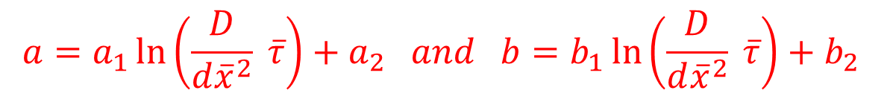
Path Of Protrusion
$$P_{\left\{x−dx\right\}}=f_{1}×AoP(x, P_{x})$$
$$f_{1}=a ln\left(wave front number\right)+b$$
$$a=a_{1}\ln\left(\frac{D}{d{\overline{x}}^{2}} \overline{τ}\right)+a_{2} and b=b_{1}\ln\left(\frac{D}{d{\overline{x}}^{2}} \overline{τ}\right)+b_{2}$$
Where a1, a2, b1 and b2 and found by curve fitting
Model | A1 | A2 | B1 | B2
Goldbeter | -0.0305 | 0.0068 | 0.0858 | 0.033
Dupont | -0.0398 | -0.0064 | 0.0931 | 0.0576

Slide 4
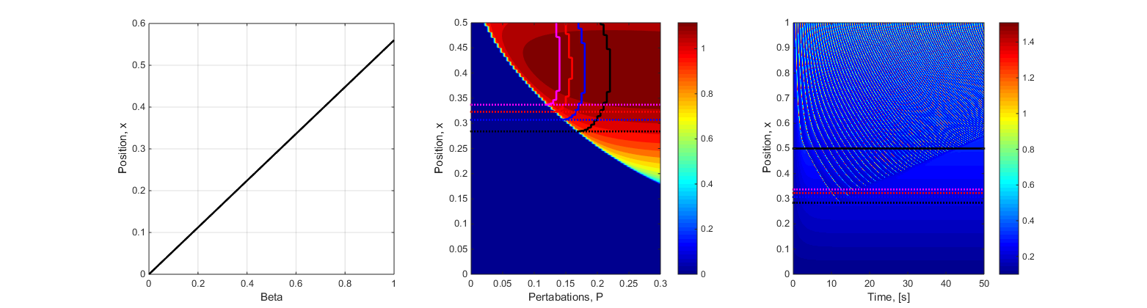
For Linear Beta to x Profile- Goldbeter
Beta Profile
AoP Grid to predict Depth
Actual Depth Plotted

Slide 5
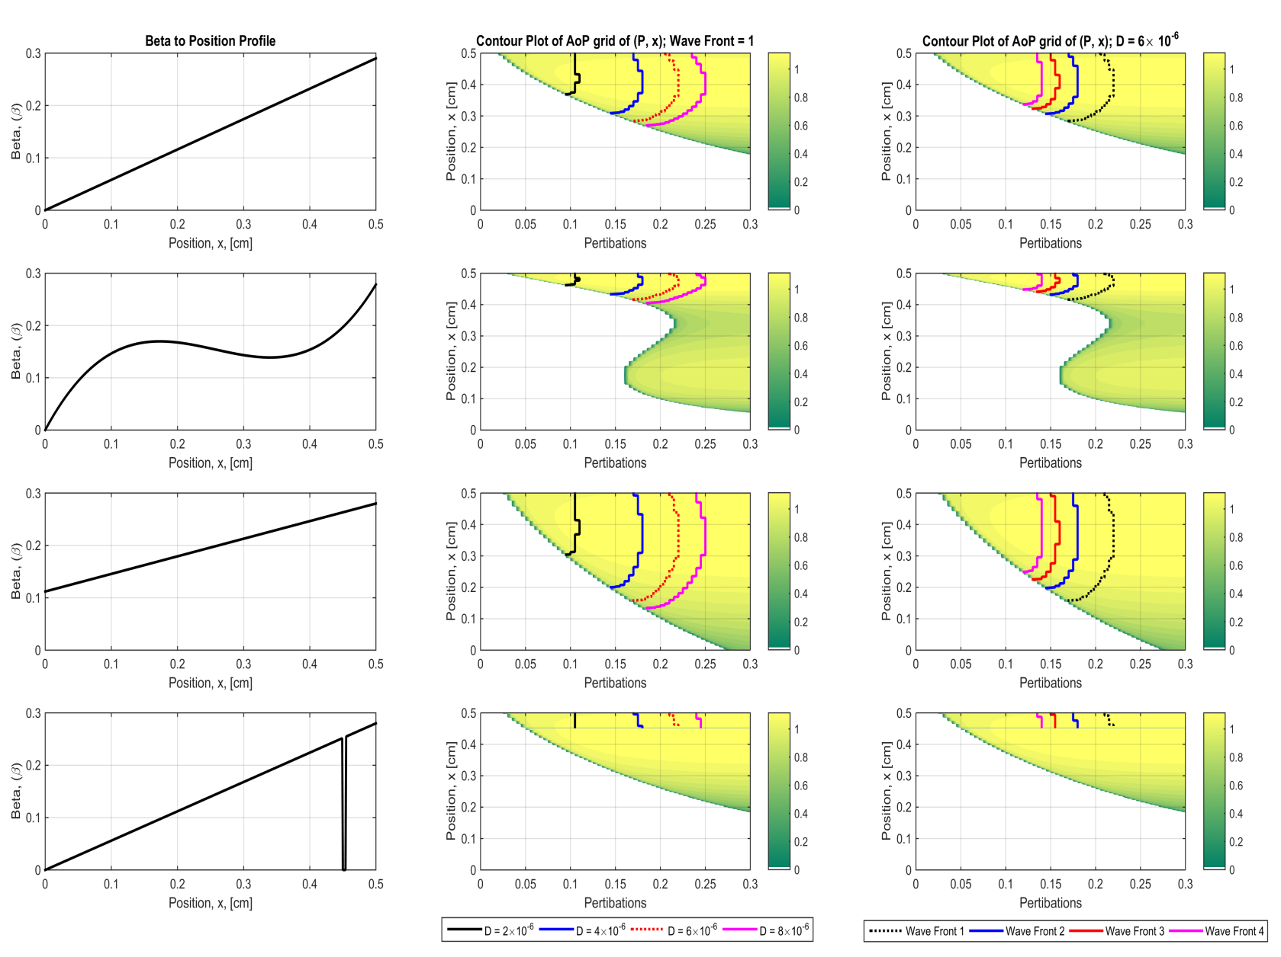
Different Wave Profiles

Slide 6
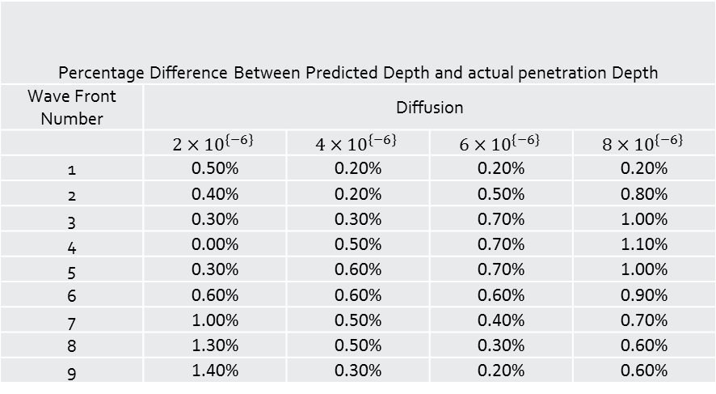
Goldbeter
Percentage Difference Between Predicted Depth and actual penetration Depth
Wave Front Number | Diffusion
 | $$2×{10}^{\left\{−6\right\}}$$ | $$4×{10}^{\left\{−6\right\}}$$ | $$6×{10}^{\left\{−6\right\}}$$ | $$8×{10}^{\left\{−6\right\}}$$
1 | 0.50% | 0.20% | 0.20% | 0.20%
2 | 0.40% | 0.20% | 0.50% | 0.80%
3 | 0.30% | 0.30% | 0.70% | 1.00%
4 | 0.00% | 0.50% | 0.70% | 1.10%
5 | 0.30% | 0.60% | 0.70% | 1.00%
6 | 0.60% | 0.60% | 0.60% | 0.90%
7 | 1.00% | 0.50% | 0.40% | 0.70%
8 | 1.30% | 0.50% | 0.30% | 0.60%
9 | 1.40% | 0.30% | 0.20% | 0.60%

Slide 7
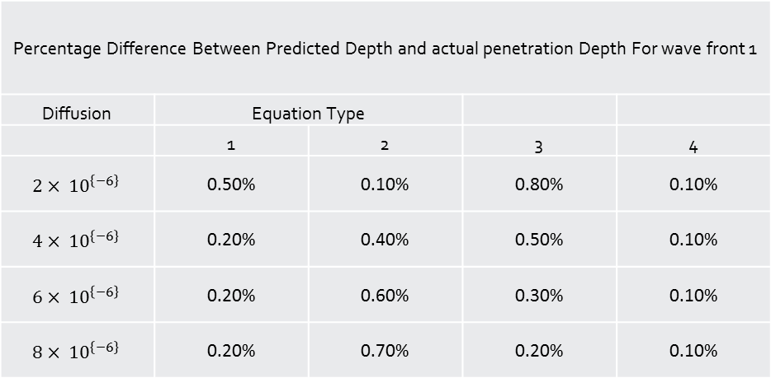
Goldbeter
Percentage Difference Between Predicted Depth and actual penetration Depth For wave front 1
Diffusion | Equation Type
 | 1 | 2 | 3 | 4
$$2× {10}^{\left\{−6\right\}}$$ | 0.50% | 0.10% | 0.80% | 0.10%
$$4× {10}^{\left\{−6\right\}}$$ | 0.20% | 0.40% | 0.50% | 0.10%
$$6× {10}^{\left\{−6\right\}}$$ | 0.20% | 0.60% | 0.30% | 0.10%
$$8× {10}^{\left\{−6\right\}}$$ | 0.20% | 0.70% | 0.20% | 0.10%

Slide 8
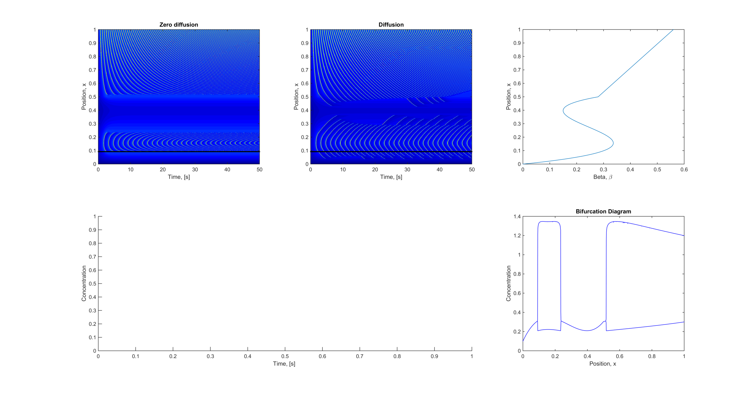
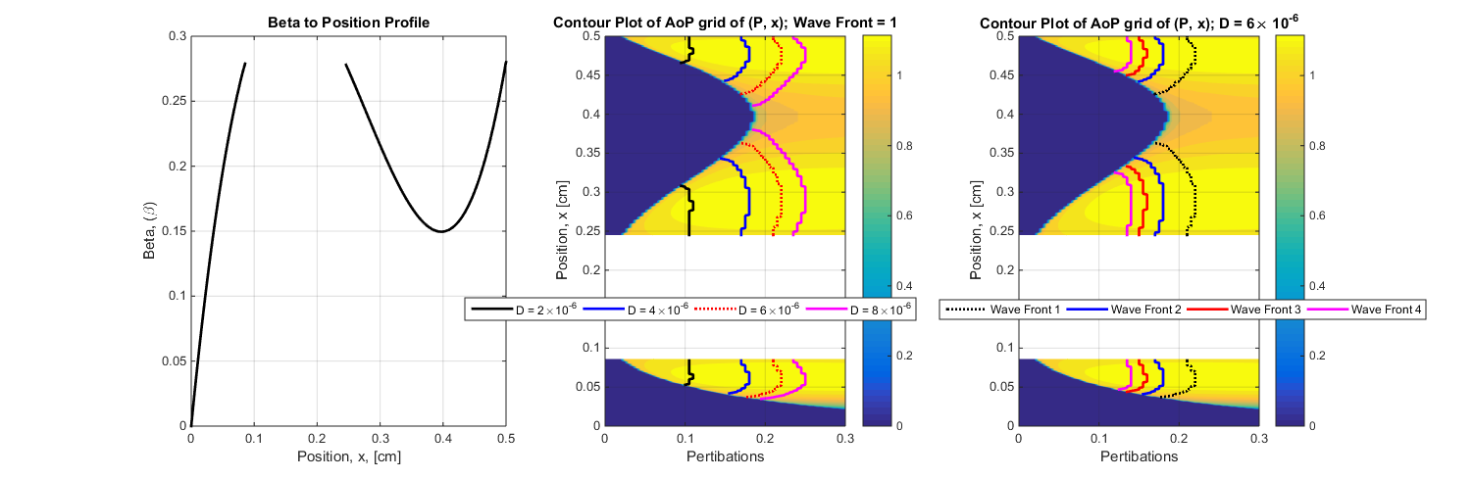

Slide 9

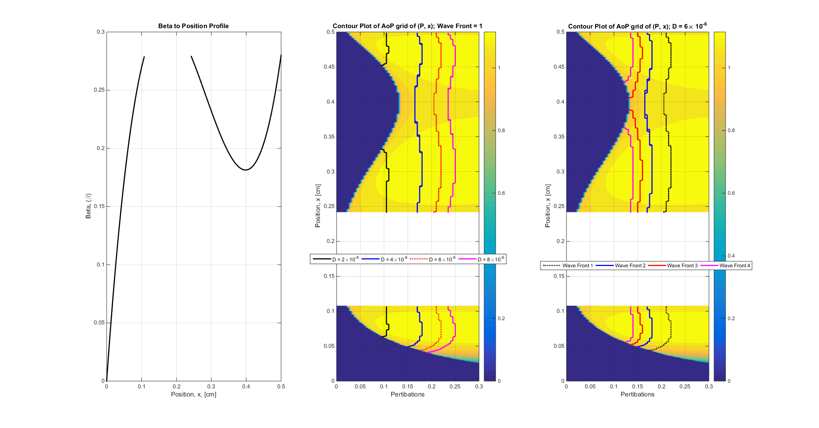

Slide 10
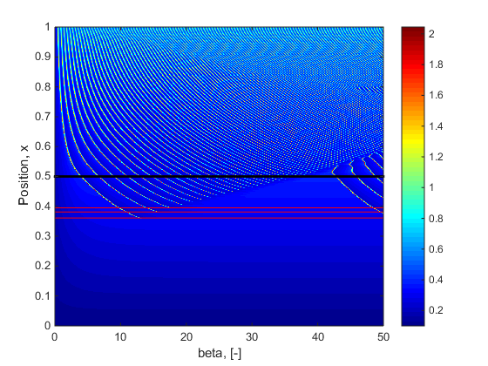
Dupont

Slide 11
Dupont Results
Equation Type | Diffusion | Wave | Predicted | Actual | Percentage Error
1 | 2 | 1 | 0.393 | 0.393 | 0
1 | 2 | 2 | 0.409 | 0.409 | 0
1 | 2 | 3 | 0.42 | 0.42 | 0
1 | 4 | 1 | 0.361 | 0.361 | 0
1 | 4 | 2 | 0.381 | 0.382 | 0.1
1 | 4 | 3 | 0.395 | 0.396 | 0.1
1 | 6 | 1 | 0.348 | 0.347 | 0.1
1 | 6 | 2 | 0.368 | 0.372 | 0.4
1 | 6 | 3 | 0.383 | 0.388 | 0.5
1 | 8 | 1 | 0.339 | 0.34 | 0.1
1 | 8 | 2 | 0.36 | 0.367 | 0.7
1 | 8 | 3 | 0.376 | 0.385 | 0.9
2 | 2 | 1 | 0.467 | 0.47 | 0.3
2 | 2 | 2 | 0.472 | 0.48 | 0.8
2 | 2 | 3 | 0.476 | 0.484 | 0.8
2 | 4 | 1 | 0.454 | 0.459 | 0.5
2 | 4 | 2 | 0.462 | 0.471 | 0.9
2 | 4 | 3 | 0.467 | 0.476 | 0.9
2 | 6 | 1 | 0.448 | 0.454 | 0.6
2 | 6 | 2 | 0.457 | 0.467 | 1
2 | 6 | 3 | 0.463 | 0.473 | 1
2 | 8 | 1 | 0.444 | 0.451 | 0.7
2 | 8 | 2 | 0.453 | 0.465 | 1.2
2 | 8 | 3 | 0.46 | 0.472 | 1.2
3 | 2 | 1 | 0.322 | 0.322 | 0
3 | 2 | 2 | 0.348 | 0.339 | 0.9
3 | 2 | 3 | 0.366 | 0.352 | 1.4
3 | 4 | 1 | 0.269 | 0.268 | 0.1
3 | 4 | 2 | 0.301 | 0.291 | 1
3 | 4 | 3 | 0.325 | 0.308 | 1.7
3 | 6 | 1 | 0.247 | 0.244 | 0.3
3 | 6 | 2 | 0.28 | 0.271 | 0.9
3 | 6 | 3 | 0.305 | 0.291 | 1.4
3 | 8 | 1 | 0.233 | 0.23 | 0.3
3 | 8 | 2 | 0.267 | 0.261 | 0.6
3 | 8 | 3 | 0.293 | 0.284 | 0.9
4 | 2 | 1 | 0.455 | 0.455 | 0
4 | 2 | 2 | 0.455 | 0.455 | 0
4 | 2 | 3 | 0.455 | 0.456 | 0.1
4 | 4 | 1 | 0.455 | 0.455 | 0
4 | 4 | 2 | 0.455 | 0.455 | 0
4 | 4 | 3 | 0.455 | 0.455 | 0
4 | 6 | 1 | 0.455 | 0.455 | 0
4 | 6 | 2 | 0.455 | 0.455 | 0
4 | 6 | 3 | 0.455 | 0.455 | 0
4 | 8 | 1 | 0.455 | 0.455 | 0
4 | 8 | 2 | 0.455 | 0.455 | 0
4 | 8 | 3 | 0.455 | 0.455 | 0

